Slide 1
Operator Observance Audit-10 Cycle Check in Forging Module-1 (Prithla Plant) Implementation Plan

Slide 2

CFT For Operator Observance Audit-10 Cycle Check in Forging Module-1 (Prithla Plant)
Facilitator and Co-Ordinator
(Mr. Ashok Rana)
CFT-1
Shop Guru
(Mr. Rajiv Gupta)
Team Members
Mr. Pramod
Mr. Dulichand
Mr. Subhash
Mr. Om Prakash
Mr. Gopal Prasad
Mr. Vinod
Mr. Satyavir
Mr. Alok Dixit

Slide 3
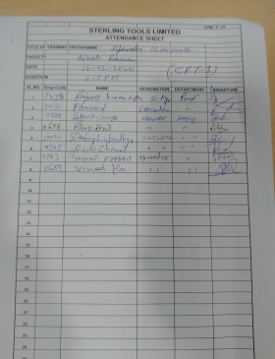
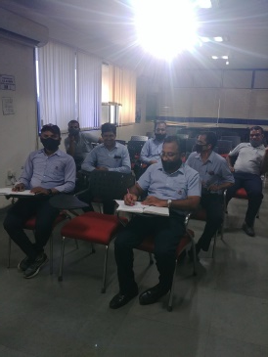
CFT Meeting-1
Date : 12.6.2020
Time : 2:00 pm to 3:00 pm
Venue: Training room Prirhla
Attendance:
CFT Members | Ashok Rana | Rajeev Gupta | Pramod | Dulichand | Subhash | Om Prakash | Gopal prasad | Vinod | Satyavir | Alok Dixit
12.6.2020
MOM
Sl. No. | Point Discussed | Resp. | Tgt. Date
1 | Retraining provided to all CFT Team Members | Ashok Rana | Done
2 | All CFT members to bring 10 rules each which should be followed in forging module-1 | CFT members | 15.6.2020, Done
3 | Next Meeting fixed on 15.6.2020 , 2 pm to 3 pm | Ashok Rana | 15.6.2020, Done
Social Distancing Ensured

Slide 4
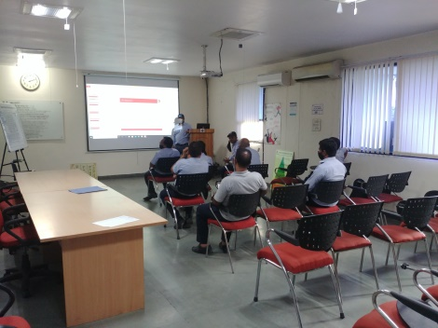
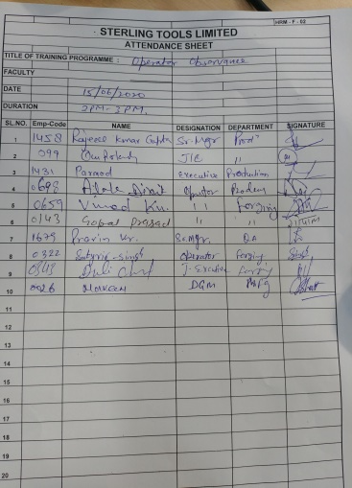
CFT Meeting-2
Date : 15.6.2020
Time : 2:00 pm to 3:00 pm
Venue: Training room Prirhla
Attendance:
CFT Members | Ashok Rana | Rajeev Gupta | Pramod | Dulichand | Subhash | Om Prakash | Gopal prasad | Vinod | Satyavir | Alok Dixit
12.6.2020
15.6.2020
Mr. Naveen Bhatt and Mr. Pravin Kumar Joined the CFT -2 meeting and shared their ideas
Social Distancing Ensured

Slide 5
CFT Meeting-2
Check points shared by Team Members
Rajiv Gupta | Dulichand | Pramod | Om Prakash
Maintain 1S/2S Wire loading and unloading details on down time report Raw material tag on m/c Every Route card to be signed by forging and rolling operator. QC ok stamp on every route card. 4M change stamp on route card for 4M changer Bin no. to be put on forging and rolling down time register. IR report to be filled hourly . Last pc. Inspection report filled Shift end pcs. To be hang on board Daily m/c check sheet to be filled shift wise Don’t forward material w/o pan tray inspection Rolling die life card to be filled daily Every bin have route card. No overfilling of bin Cover on every bin Laps to be checked daily at start of shift | Conveyor to stop when forging m/c stop in combined m/c 0192 series 3rd station chisel size to be bigger than 4th station Sensor for extra material on flange Transfer assembly spare parts to be available in store. 0192 hex pin size to be same length 1st extrusion new die size is less , when polished , coating goes away Rusty wire Scratch mark dent on wire | M/c Poka-yoke checking and recording shift wise. Gauges availability as per drawing / check sheet and calibration Operator availability on m/c. Sign and time on IR report. TGW available on m/c. and know how Operator understanding of drawing. | 1.Rolling small bin are open 2. Third die concavity not made. 3. TRD of new die less 4. Route card available on m/c 5. No left over part on m/c 6. Oil near m/c 7. New bin should be clean / condition of bin should be ok. 8. panny, gatta, ikapda, n bin. 9. Down time to be recorded at the real time. 10. Pressure gauge condition

Slide 6
CFT Meeting-2
Check points shared by Team Members
Gopal | Vinod | Alok Dixit | Satyavir
Oil leakage on m/c No parts on floor. Conveyor should not be direct. IR sheet maintain. Overload meter setting . 1st approval pc. On m/c Transfer repair schedule. | Wire to be checked as per drawing. Hex pin monogram check before changing. Conveyor C1 to be stopped during running while checking parts. No compromise from drawing | Shift start check tightening of dies and parts as per check sheet. Conveyor condition | Cleaning of m/c at the time of setting. Stop call wait for abnormal condition. Awareness of WI, SOP, check sheets Transfer to be lubricate before startup Operator handover take over

Slide 7
CFT Meeting-2
MOM
Sl. No. | Point Discussed | Resp. | Tgt. Date | Status
1 | All the team members shared their ideas of what check point should be there in operator observance audit and all ideas captured | CFT-1 | Done | Done
2 | Comprehensive operator observance check sheet to be made based on team inputs | Ashok Rana and Rajiv Gupta | 16.6.2020 | Done
3 | Next CFT meeting to finalize check points and marking criteria | Ashok Rana | 17.6.2020 | Done

Slide 8
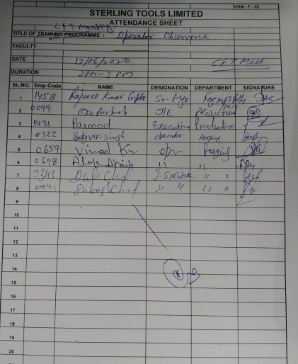
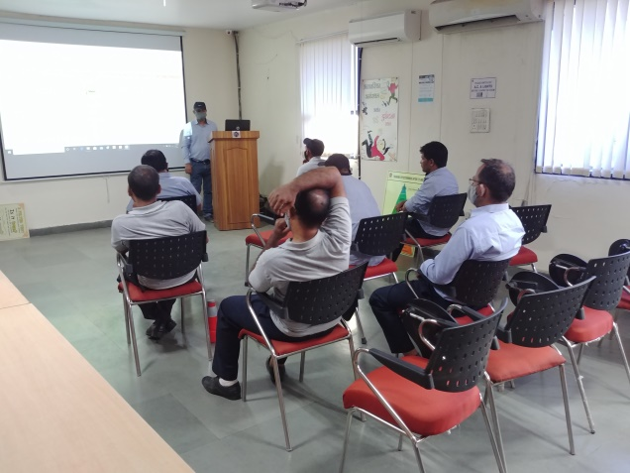
CFT Meeting-3
Date : 17.6.2020
Time : 2:00 pm to 3:00 pm
Venue: Training room Prirhla
Attendance:
CFT Members | Ashok Rana | Rajeev Gupta | Pramod | Dulichand | Subhash | Om Prakash | Gopal prasad | Vinod | Satyavir | Alok Dixit
12.6.2020
15.6.2020
17.6.2020
Social Distancing Ensured

Slide 9
CFT Meeting-3
Operator Observance Audit Check Sheet for Forging Module-1
Sterling Tools limited- Prithla Plant
10 CYCLE OPERATOR OBSERVANCE AUDIT CHECK SHEET FOR BOLT FORGING PROCESS
Operator Name : |  | M/C Name |  |  |  |  | M/c No. |  |  | CC |  |  | Module - FORGING, Module-1
Employee Code: |  | Date |  |  |  |  | Shift |  |  |  |  |  | Shop Guru -Rajiv Gupta
Check Point |  | Marks | 10 Cycle Check |  |  |  |  |  |  |  |  |  | OBSERVATIONS
 |  |  | 1 | 2 | 3 | 4 | 5 | 6 | 7 | 8 | 9 | 10
1.Operating Condition | 1. Machine and equipment clealiness | 5
 | 2. Operator is clear about all points in machine check sheet. All points are checked timely shift wise and information given for NG points. | 5
 | 3. Down time recording in real time and not at the shift end. | 5
2.Discipline | 1. Machine not unmaned while running. | 5
3. Safety | 1.Machine safety doors are closed and limit switch is working while machine running. (poka-yoke) in auto mode. | 5
 | 2.Operator is using required PPE's | 5
4.Quality Check | 1. Operator understands part drawing. | 5
 | 2. QC chart filled by operator at decided frequency with time and signature. Last pc. Checked. | 5
 | 3. Opearator is topling / forwarding small bin / tray / conveyor only after visual / gauge verification of parts. Checking Conveyor should not be direct. | 5
 | 4. Wire traceability details entered in down time register on loading and unloading. | 5
 | 5. Availability of gauges as per drawing/ QC chart and they are calibrated. | 5
 | 6.Set-up parts are kept with identification at inspection station. | 5
5. Poka-Yoke | 1. Short feed sensor is verified by opeartor and working. | 5
 | 2. Trimming plate installed for trimming parts. | 5
6.Tool control | 1. Tool issue only by tool issue slip signed by QA Inspector and production Supervisor | 5
7.Abnormility handling | 1. Operator understand and handle abnormality as per Work instruction of Indentification and control of abnormal situation. Stop, Call, Wait followed for abnormality handling. | 5
 | 2. Red bin available on m/c and fallen parts and rejected parts kept in red bin. | 5
8. 4M | 1. Operator follows 4 M change control incase of tool / machine breakdown. Reflected in IR sheet. 4M change stamp on route card. | 5
9. Material handling and control | 1.Correct route card in every bin, and route card signed by operator. | 5
 | 2. Wire tag available on m/c. | 5
 | 3. Bin no. entry in down time register. | 5
 | 4. No over stacking of bins and spillage in conveyors and cover on every filled bin, | 5
10. Mix-up prevention | 1. Opearator understands and follows mix-up prevention rules. | 5
 | Total Marks | 115
 | Marks Obtained
 | Percentage
 | Operator signature
 | Auditor Signature

Slide 10
CFT Meeting-3
Operator Observance Audit Check Sheet for Forging Module-1 Marking guidelines and cycle
Sterling Tools limited- Prithla Plant
10 CYCLE OPERATOR OBSERVANCE AUDIT CHECK SHEET FOR BOLT FORGING PROCESS
Marking Guidelines
Check Point |  | Cycle | Marks | Guidelines (Mark 0 or 5)
1.Operating Condition | 1. Machine and equipment clealiness | Once | 5 | * Verify 1S/2S in and around m/c when audit starts
 | 2. Operator is clear about all points in machine check sheet. All points are checked timely shift wise and information given for NG points. | Once | 5 | *Check 2-3 points along with operator at start of audit
 | 3. Down time recording in real time and not at the shift end. | 10 times | 5 | * Check when m/c starts after stoppage
2.Discipline | 1. Machine not unmaned while running. | 10 times | 5 | * Check operator availability on m/c at m/c running time.
3. Safety | 1.Machine safety doors are closed and limit switch is working while machine running. (poka-yoke) in auto mode. | Once | 5 | * Check by opening door, m/c should stop
 | 2.Operator is using required PPE's | 10 times | 5 | * Operator is wearing required PPE's (Shoes, hand gloves, Ear plugs) while working.
4.Quality Check | 1. Operator understands part drawing. | Once | 5 | * Ask operator explain drawing at start of audit
 | 2. QC chart filled by operator at decided frequency with time and signature. Last pc. Checked. | 10 times | 5 | * Also crosscheck 2-3 dimensions. Check once as per record during 10 cycle check
 | 3. Opearator is topling / forwarding small bin / tray / conveyor only after visual / gauge verification of parts. Checking Conveyor should not be direct. | 10 times | 5 | * Observe operator from a distance, what operator does.
 | 4. Wire traceability details entered in down time register on loading and unloading. | Once | 5 | * Check down time register detials with wire tag.
 | 5. Availability of gauges as per drawing/ QC chart and they are calibrated. | Once | 5 | * Check gauges availability and calibration status
 | 6.Set-up parts are kept with identification at inspection station. | Once | 5 | * Check set-up date and time
5. Poka-Yoke | 1. Short feed sensor is verified by opeartor and working. | Once | 5 | * Check short feed sensor working
 | 2. Trimming plate installed for trimming parts. | Once | 5 | * Check trimming plate
6.Tool control | 1. Tool issue only by tool issue slip signed by QA Inspector and production Supervisor | Once | 5 | * Check tool issue slip with tool store.
7.Abnormility handling | 1. Operator understand and handle abnormality as per Work instruction of Indentification and control of abnormal situation. Stop, Call, Wait followed for abnormality handling. | Once | 5 | * Check operator understanding
 | 2. Red bin available on m/c and fallen parts and rejected parts kept in red bin. | Once | 5 | * Check parts in red bin. Check wether operator is picking fallen parts and putting in red bin
8. 4M | 1. Operator follows 4 M change control incase of tool / machine breakdown. Reflected in IR sheet. 4M change stamp on route card. | Once | 5 | * Verify from record. Do it purposely
9. Material handling and control | 1.Correct route card in every bin, and route card signed by operator. | 10 times | 5 | * Check route card
 | 2. Wire tag available on m/c. | Once | 5 | * Check wire tag
 | 3. Bin no. entry in down time register. | Once | 5 | * Check down time register
 | 4. No over stacking of bins and spillage in conveyors and cover on every filled bin, | 10 times | 5 | * Check bin and conveyor
10. Mix-up prevention | 1. Opearator understands and follows mix-up prevention rules. | 10 times | 5 | * Check operaraor understand rules and follows
 | Total Marks |  | 115
 | Marks Obtained
 | Percentage
 | Operator signature
 | Auditor Signature

Slide 11
CFT Meeting-3
MOM
Sl. No. | Point Discussed | Resp. | Tgt. Date | Status
1 | Check points, their check cycle, their marking criteria finalized and agreed by all CFT members. | CFT-1 | 17.6.2020 | Done
2 | Organization chart for Operator observance audit to be made | Ashok Rana, Rajiv Gupta | 18.6.2020 | Done
3 | Plan for operator observance audit to be made. | Ashok Rana, Rajiv Gupta | 18.6.2020 | Done

Slide 12
Operator Observance Audit Plan for Forging module-1 (Prithla Plant)
OPERATOR OBSERVANCE AUDIT PLAN FOR FORGING MODULE-1 (PRITHLA PLANT))
S.No | Auditor | Name | DEPTT. | LEVEL | MONTH
 |  |  |  |  | Jul-20 | Aug-20 | Sep-20 | Oct-20 | Nov-20 | Dec-20 | Jan-21 | Feb-21 | Mar-21 | Apr-21 | May-21 | Jun-21
1 | Pramod | Dharambir | FORGING | L-4
2 | Pramod | Rajender Singh | FORGING | L-4
3 | Pramod | Bijender Bairagi | FORGING | L-3
4 | Subhash | Mainuddin Ansari | FORGING | L-4
5 | Subhash | Shyam Bihari | FORGING | L-4
6 | Subhash | Sudhir Kumar | FORGING | L-3
7 | Duli Chand | Asim Pore | FORGING | L-4
8 | Duli Chand | Gopal Prasad | FORGING | L-4
9 | Duli Chand | Ashok Kumar Sharma | FORGING | L-3
10 | Om Prakash | Pradeep Kumar Sharma | FORGING | L-3
11 | Om Prakash | Rishi Pal | FORGING | L-3
12 | Om Prakash | Satayvir Singh | FORGING | L-4
13 | Vinod | Tek Chand | FORGING | L-3
14 | Vinod | Praveen Kumar | FORGING | L-4
15 | Vinod | Virender Kumar Sharma | FORGING | L-3
16 | Satyavir | Sushil Kumar | FORGING | L-3
17 | Satyavir | Vishnu | FORGING | L-3
18 | Satyavir | Mukesh Kumar | FORGING | L-3
19 | Gopal Prasad | Gopal Singh | FORGING | L-3
20 | Gopal Prasad | Mahesh Chand Rawat | FORGING | L-3
21 | Gopal Prasad | Pankaj Kumar | FORGING | L-3
22 | Alok Dixit | Vinod Kumar | FORGING | L-4
23 | Alok Dixit | Harender Kumar | FORGING | L-3
24 | Alok Dixit | Dhiraj Singh | FORGING | L-3
25 | Pramod | Akhilesh Sharma | FORGING | L-3
26 | Pramod | Alok Kr.Dixit | FORGING | L-4
27 | Pramod | Devender Kumar | FORGING | L-3
28 | Subhash | Ravendra Kumar | FORGING | L-3
29 | Subhash | Krishan Kumar | FORGING | L-3
30 | Subhash | Shiv Avtar | FORGING | L-3
31 | Duli Chand | Ajay Pratap Singh | FORGING | L-3
32 | Duli Chand | Rakesh Kr.Tiwari | FORGING | L-3
33 | Duli Chand | Virender Pal Singh | FORGING | L-3
34 | Om Prakash | Akhilesh Kr.Prasad | FORGING | L-3
35 | Om Prakash | Jitendra Kumar | FORGING | L-3
36 | Om Prakash | Alveen Rana | FORGING | L-3
37 | Vinod | Lalit Kumar | FORGING | L-3
38 | Vinod | Rajesh Kumar | FORGING | L-3
39 | Vinod | Ravinder Kumar | FORGING | L-3
40 | Satyavir | Sri Kishun | FORGING | L-3
41 | Satyavir | Barun Pandey | FORGING | L-4
42 | Satyavir | Sanjay Verma | FORGING | L-3
43 | Gopal Prasad | Paramveer Singh | FORGING | L-3
44 | Gopal Prasad | Sarvan Kumar | FORGING | L-3
45 | Alok Dixit | Sanjay Kumar | FORGING | L-3
46 | Alok Dixit | Sidhari Yadav | FORGING | L-3
47 | Alok Dixit | Neeraj Bangari | FORGING | L-3
48 | Pramod | Pankaj Kumar Mishra | FORGING | L-3
49 | Pramod | Ratan Lal | FORGING | L-3
50 | Pramod | Jai Ram | FORGING | L-3
51 | Subhash | Amar Kant | FORGING | L-3
52 | Subhash | Yashpal | FORGING | L-3
53 | Subhash | Anil Kumar | FORGING | L-3
54 | Duli Chand | Prabhakar Singh | FORGING | L-3
55 | Duli Chand | Kapil Kumar | FORGING | L-4
56 | Duli Chand | Avdesh | FORGING | L-3

